Slide 1
A Voice for autism
DEC1606
Client: Josh Abbott (Micron)
Advisor: Dr. Hegde
Cameron Cornick
Ashlyn Freestone
Zachary Snyder
Wen-Chi Hsu
Yiru Gao

Slide 2
Problem Statement
Our goal is to build a device that can help those with autism communicate with others.
Assistive and Augmentative Communication (AAC) devices exist to allow people to communicate in more ways
Types range from “card readers” to high end tablets.
Why?

Slide 3
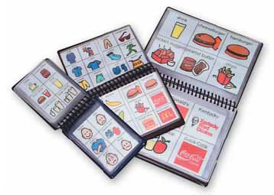
Market survey
Need for Assistive Communication Devices
Current Devices range in price from:
$500 to $8500
Major devices clunky and inconvenient

Slide 4
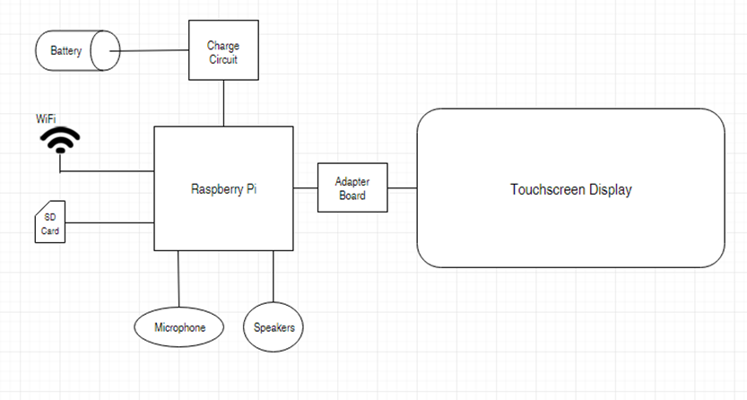
Conceptual Sketch

Slide 5
Requirements To Get The Job Done
Functional:
Robust
User-Friendly
Power To Run All Day
Production Cost <$200
Voice Recognition
Non-Functional:
Adjustable to Age Level
Use Micron Memory
Customizable to Preference

Slide 6
Potential Risks & Testing
Risks:
Breaking the Device
Learning Curve of Device
User Information
Tracking of Habits and Travel
Battery Safety
Testing
Vibration/Shake Test
Usability Questionnaire
Charge/Discharge Cycle test

Slide 7
Overview of Software Design

Slide 8
Overview of User Interface

Slide 9
Launch Topic

Slide 10
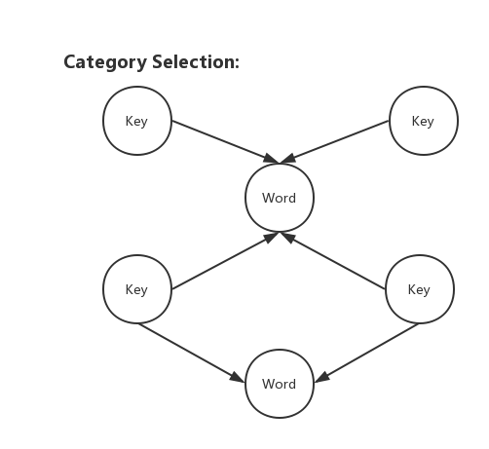
WordNet
Structure of WordNet
Superordinate
Subordinate
Sister Term
Frequency

Slide 11
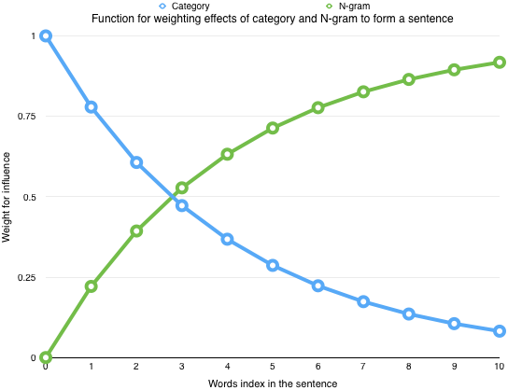
Heuristic function for Words suggestion
Heuristic prediction function:
C * e ^ ( - x / 4 ) + g ( 1 - e ^ ( - x / 4 ) )

Slide 12
Receive

Slide 13
Hardware – ARM Processor
Why?
Low Power
Cheap
Flexible
Issues?
Designing a Board with large amounts of other components
How?
Raspberry Pi
Popular Single Board Computer
Many Available Add-ons
Arduino DUE
Popular Hobby Board, No Display Drivers
BeagleBone
Popular Hobby Board, Not designed for Displays

Slide 14
How Many Board Design?
Golden Design: Everything made and designed by our group
The Reality:
Using Solutions already made so that there is time to get to our own form of solution
A massive team of engineers would be needed for the “Golden Design”.
Issues with a single board design:
Requires fully laying out a board:
Including Matched memory lines and countless other requirements.
Special facilities
Team needs to learn how to lay out a multi-hundred component board
More flexibility with a multi-board design.

Slide 15
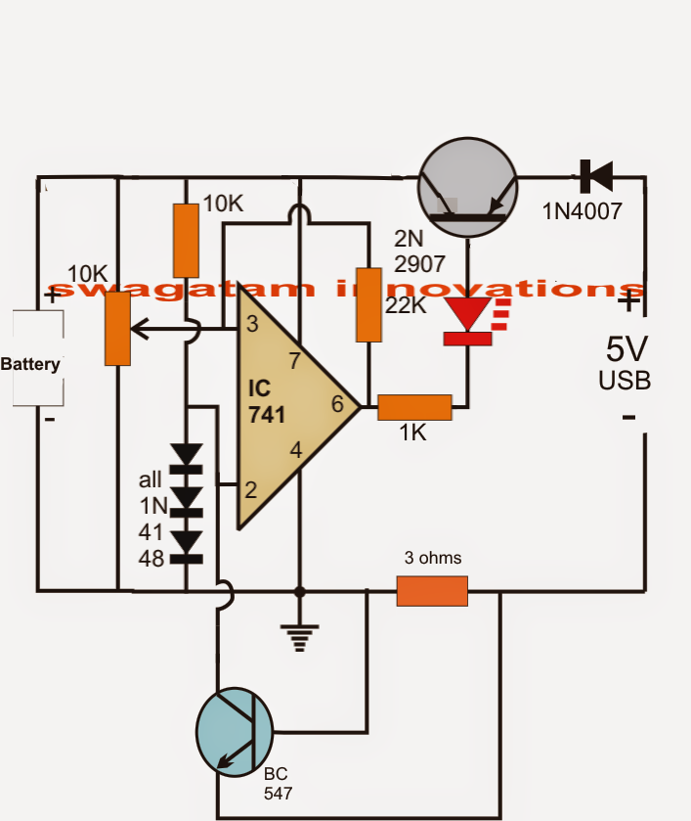
Battery Charging Circuit??
Explored Solutions
IC chip
Comparator
Future

Slide 16
IC approach
Takes up less space
Less components

Slide 17
Surface mount to DIP
Necessary for testing circuit
Soldering

Slide 18
Current Project Status
Hardware:
Working Hardware Interface with some Battery Charging
Testing and Adding Last Pieces
Software:
Application Prototype Completed
Word Dictionary Completed
Word Suggestion In Process

Slide 19
Task Responsibility – Cum Hours: 584
Cameron Cornick – Team Leader
Ashlyn Freestone - Team Communication Leader
Wen-Chi Hsu – Team Webmaster #1
Yiru Gao – Team Webmaster #2
Zach Snyder – Team Key Concept Holder

