Slide 1
A Voice for autism
DEC1606
Client: Josh Abbott (Micron)
Advisor: Dr. Hegde
Cameron Cornick
Ashlyn Freestone
Zachary Snyder
Wen-Chi Hsu
Yiru Gao

Slide 2
Problem Statement
Our goal is to build a device that can help those with autism communicate with others.
AAC (Assistive and Augmentative Communication) devices exist to allow people to communicate in more ways
Types range from “card readers” to high end tablets.
Why?

Slide 3
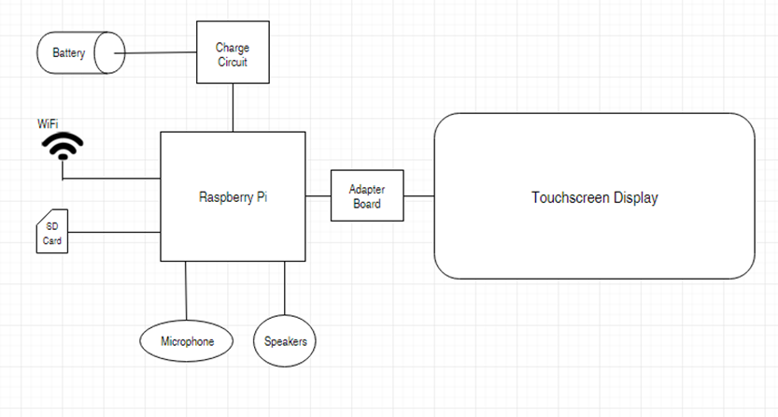
Conceptual Sketch

Slide 4
Requirements To Get The Job Done
Functional:
Robust
User-Friendly
Power To Run All Day
Production Coast <$200
Voice Recognition
Non-Functional:
Adjustable to Age Level
Use Micron Memory
Customizable to Preference

Slide 5
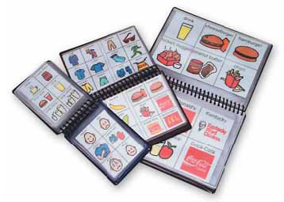
Market survey
Need for Assistive Communication Devices
Current Devices range in price from:
$500 to $8500
Major devices clunky and not easy to use.

Slide 6
Potential Risks & Mitigation
Breaking the Device
Learning Curve of Device
User Information
Tracking of Habits and Travel
Battery Safety
Design for Large Falls
Make Interface Simple & Intuitive
Secure User Information
Test to Ensure proper battery circuitry has been created

Slide 7
Resource/Cost Estimate
Goal: <$200
Cost of Prototype A:
~$100
Cost of Prototype B: (expected)
~$130
Cost of Expected Software:
$5-10

Slide 8
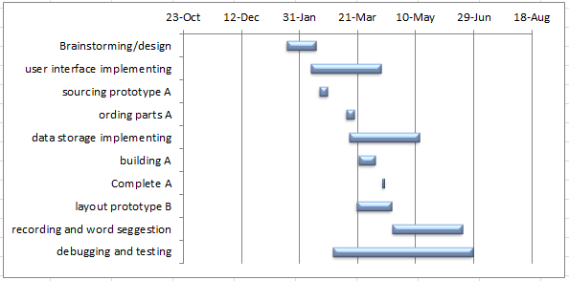
Project Milestones & Schedule
Semester One

Slide 9
Overview of Software Design

Slide 10
Overview of User Interface

Slide 11
Launch Topic

Slide 12
WordNet
Structure of WordNet
Superordinate
Subordinate
Sister Term
Frequency

Slide 13
Stanford NLP
Core NLP
Analysis of Word Type
Recognize the Meaning of Text Input
Filter for Word Suggestion

Slide 14
Receive

Slide 15
Hardware – ARM Processor
Why?
Low Power
Cheap
Flexible
Issues?
Designing a Board with large amounts of other components
How?
Raspberry Pi
Popular Single Board Computer
Many Available Add-ons
Arduino DUE
Popular Hobby Board, No Display Drivers
BeagleBone
Popular Hobby Board, Not designed for Displays

Slide 16
Touch Screen
How and Why?
Raspberry Pi 7’’ (800x480) Touchscreen
10 point multi touch
PWM Backlight Control
Plug and Play setup allows us to focus more on adding additional components

Slide 17
How Many Board Design?
Golden Design: Everything made and designed by our group
The Reality:
Using Solutions already made so that there is time to get to our own form of solution
A massive team of engineers would be needed for the “Golden Design”.
Issues with a single board design:
Requires fully laying out a board:
Including Matched memory lines and countless other requirements.
Special facilities
Team needs to learn how to lay out a multi-hundred component board
More flexibility with a multi-board design.

Slide 18
Enclosure
Goals:
Durable
Sleek Design
Custom
3-D printing

Slide 19
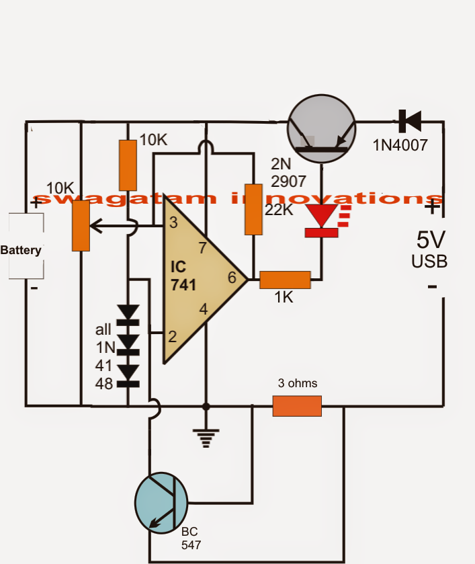
Battery Charging Circuit
Explored Solutions
IC chip
Comparator
Future

Slide 20
Current Project Status
Hardware:
Working first prototype
Plans coming to completion of second prototype
Software:
Basic application completed
Rough Drafts of Speech Interpretation Started

Slide 21
Task Responsibility – Cum Hours: 295.75
Cameron Cornick – Team Leader
Ashlyn Freestone - Team Communication Leader
Wen-Chi Hsu – Team Webmaster #1
Yiru Gao – Team Webmaster #2
Zach Snyder – Team Key Concept Holder

Slide 22
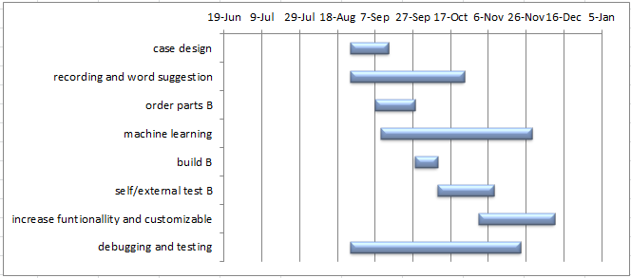
Plan for Next Semester
Semester Two

